Slide 1
IoT 101
Azure you want to use AWS IoT?
Notes:
https://www.forbes.com/sites/gilpress/2014/06/18/a-very-short-history-of-the-internet-of-things/#436401ee10de

Slide 2


Are you in the right class?
Introduction to IoT
Covering Azure and AWS IoT
Discusses basic IoT terms
Demonstrate a simple IoT use case

Slide 3

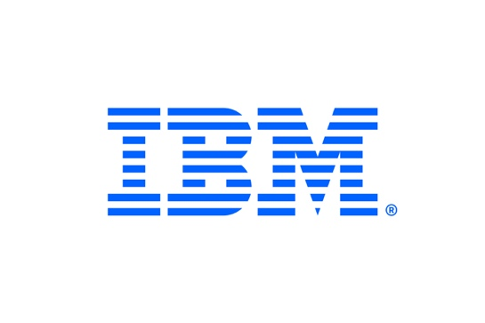





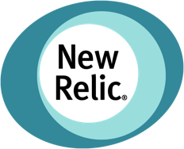








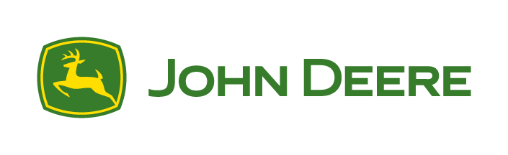




















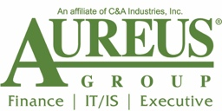








Titanium Sponsors
Platinum Sponsors
Gold Sponsors

Slide 4

About me
Software Engineer Team Lead
Live in Olathe, KS
Work at Balance Innovations

Slide 5
IoT Basics
IoT Explosion
What is IoT?
What IoT is not
IoT Terms
Why is it important to us?

Slide 6

IoT Explosion
How many internet-connected devices did you have in 2004?
How many internet-connected devices do you have today?
Notes:
Source: https://www.softwaretestinghelp.com/iot-devices/

Slide 7
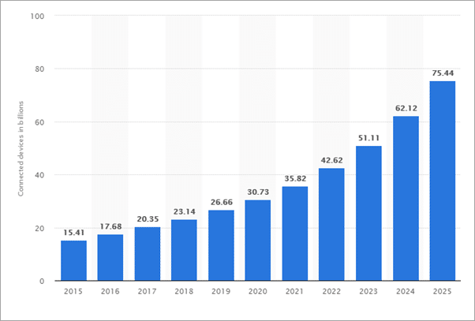
IoT Explosion
Notes:
Source: https://www.softwaretestinghelp.com/iot-devices/

Slide 8
What is IoT?
A system of connected physical devices that collect, compute, and transfer data without human interaction.
Notes:
https://internetofthingsagenda.techtarget.com/definition/Internet-of-Things-IoT
https://www.zdnet.com/article/what-is-the-internet-of-things-everything-you-need-to-know-about-the-iot-right-now/
https://www.happiestminds.com/Insights/internet-of-things/

Slide 9
What is IoT?
A system of connected physical devices that collected, compute, and transfer data without human interaction.
Notes:
https://internetofthingsagenda.techtarget.com/definition/Internet-of-Things-IoT

Slide 10
What is IoT?
A system of connected physical devices that collected, compute, and transfer data without human interaction.
Notes:
https://internetofthingsagenda.techtarget.com/definition/Internet-of-Things-IoT

Slide 11
What is IoT?
A system of connected physical devices that collected, compute, and transfer data without human interaction.
Notes:
https://internetofthingsagenda.techtarget.com/definition/Internet-of-Things-IoT

Slide 12
What is IoT?
A system of connected physical devices that collected, compute, and transfer data without human interaction.
Notes:
https://internetofthingsagenda.techtarget.com/definition/Internet-of-Things-IoT

Slide 13
What is IoT?
Basic devices
Connected devices
Proliferating scope of devices
Publicly available devices
Often less-secure devices

Slide 14
What IoT is Not
Connected devices that require human interactions
Examples
Desktops
laptops
tablets
smartphones
traditional mobile phones
TVs
DVD/MP3 players
game consoles.
Notes:
https://www.networkworld.com/article/2378581/8-internet-things-that-are-not-iot.html

Slide 15
Why IoT Matters
https://www.atkearney.com/web/atkearney-silicon-valley/future-of-the-internet-of-things
Notes:
https://www.networkworld.com/article/2378581/8-internet-things-that-are-not-iot.html

Slide 16
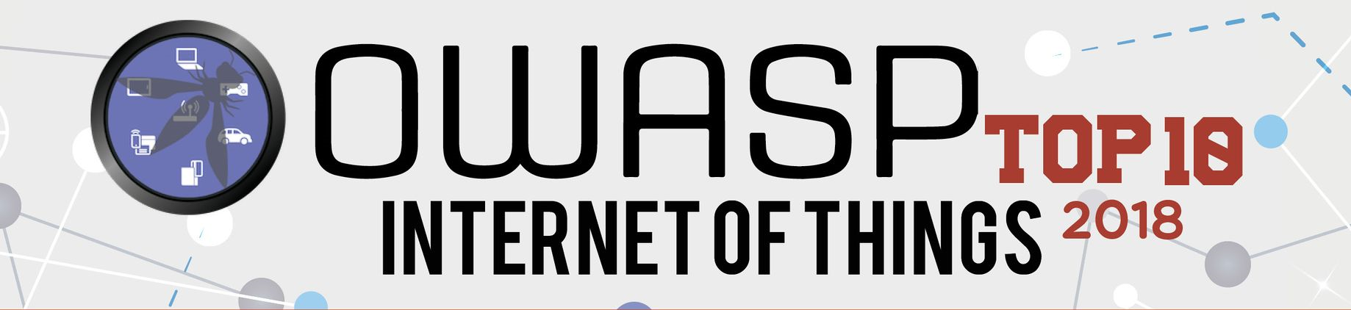
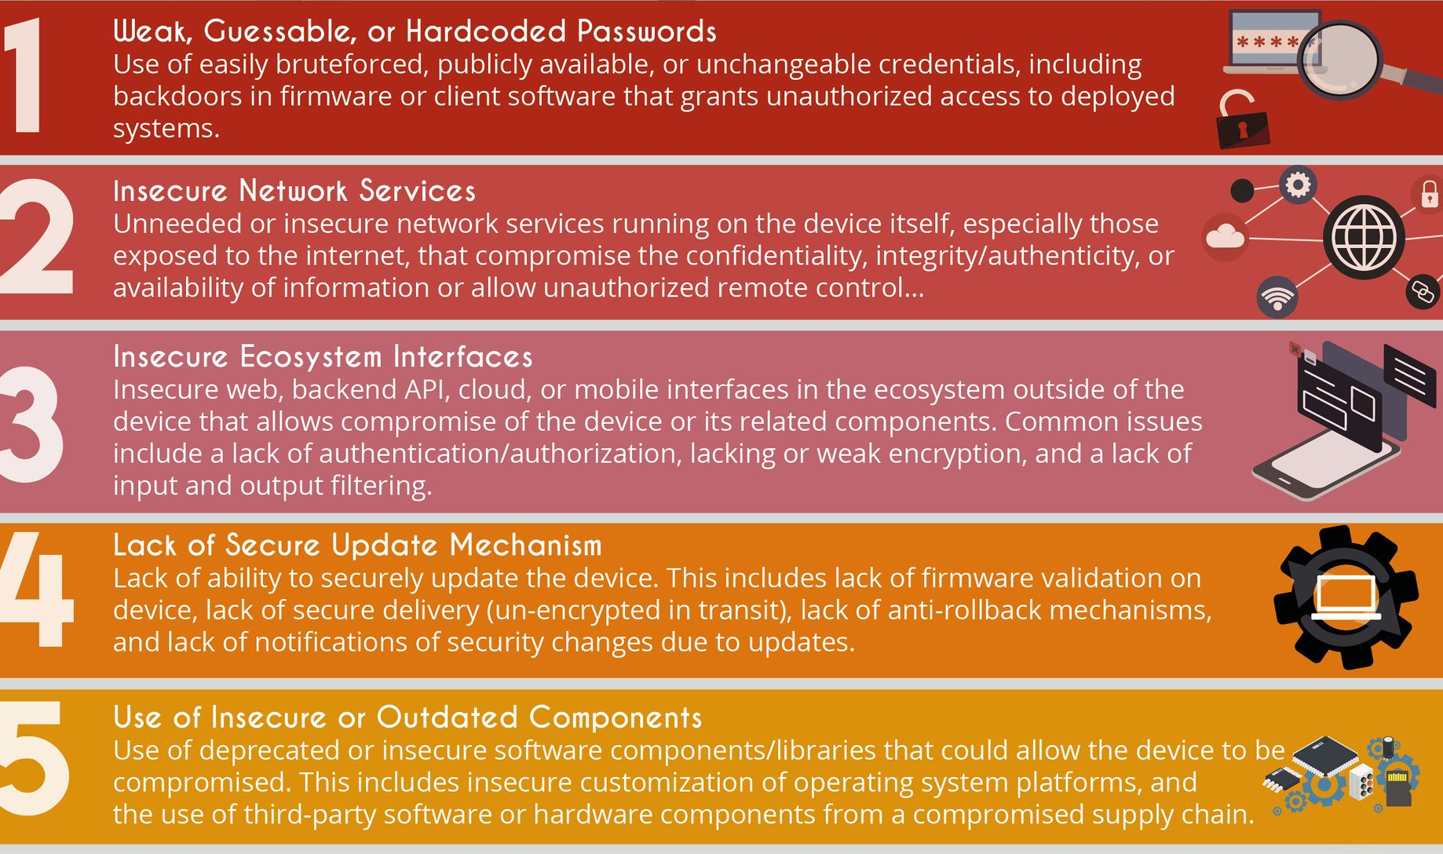
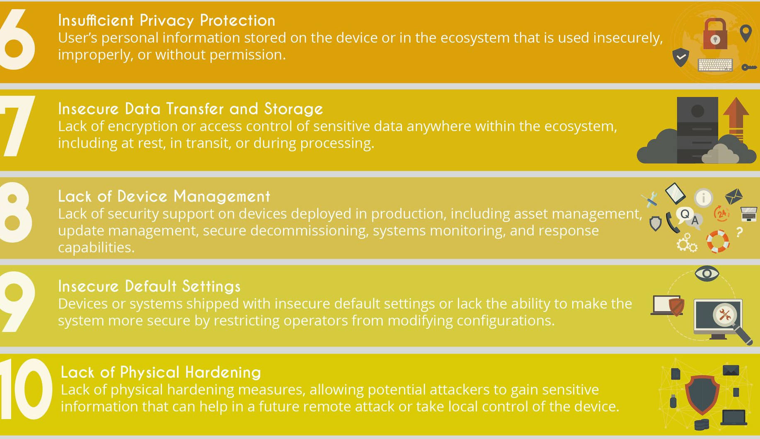
Iot Security
https://www.owasp.org/index.php/OWASP_Internet_of_Things_Project
Notes:
https://www.networkworld.com/article/2378581/8-internet-things-that-are-not-iot.html

Slide 17
Terms
Edge Device
Wearbles
NFC (Near-Field Communication)
BLE (Bluetooth Low Energy)
Edge Computing
Smart Home
Gateway
Cloud computing
Event-driven architecture
Notes:
https://www.telit.com/blog/iot-glossary-10-key-terms/
https://dzone.com/articles/iot-glossary-terms-you-need-to-know
https://www.microcontrollertips.com/terminology-used-in-the-internet-of-things/
https://www.belimo.com/mam/americas/pictures_and_graphics/marketing/teaser_images/iot/MAN18_Belimo_IoT_Glossary_EN-US.pdf

Slide 18
Why is iot Important
Services must be
Scalable
Secure
Fast
Payloads must be lightweight
Security-first mentality

Slide 19
AWS vs Azure
Device
Permissions
Routing

Slide 20
Aws

Slide 21
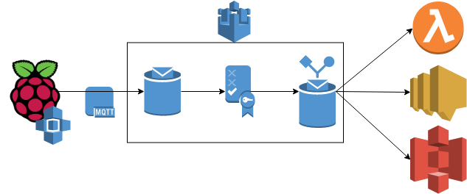
AWS Iot

Slide 22
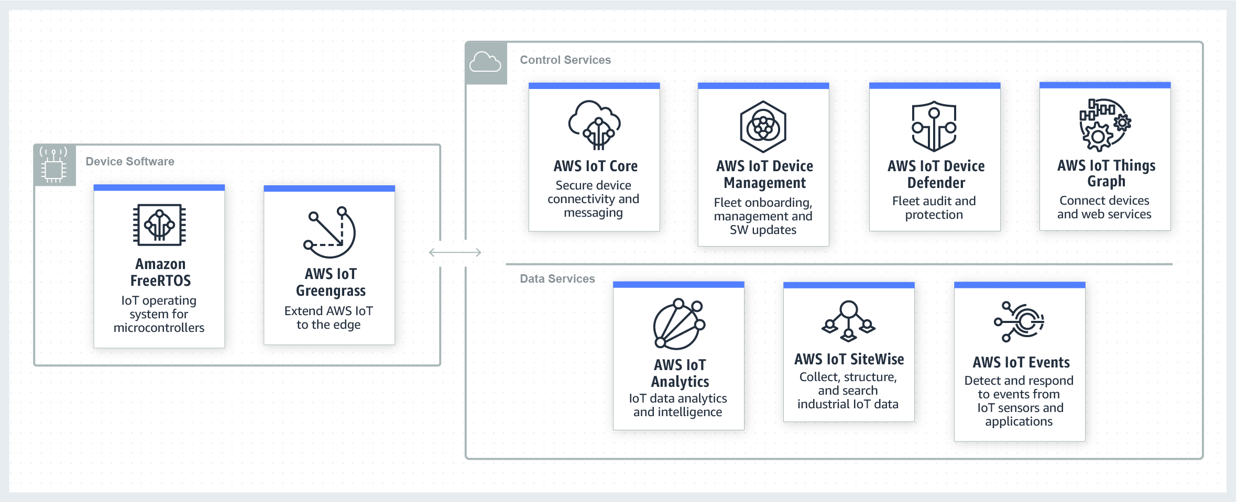
AWS Iot

Slide 23
AWS iot
MQTT
HTTP
Web Sockets

Slide 24
AWS iot
Thing
Types
Groups
Attributes
Shadow
Reported
Desired
Policy
Rule

Slide 25
Azure

Slide 26
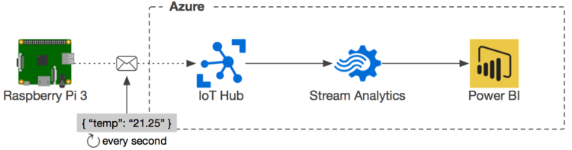
AZure iot

Slide 27
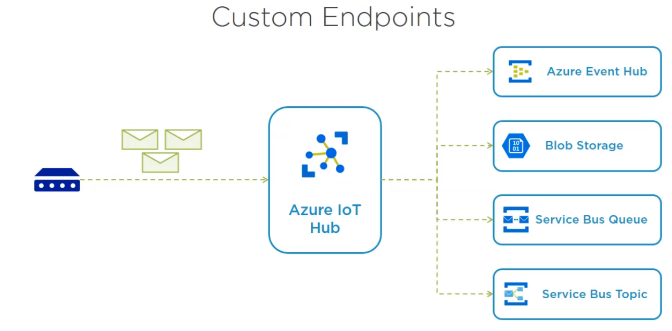
AZure iot

Slide 28
AWS iot
Device Twin
Source of truth: IoT Hub
Properties (reported & desired)
Tags (cloud only, allows grouping & queries)
Connection security
Shared access key
Issue tokens externally
X.509 Certificates
Use Policies
& more…

Slide 29
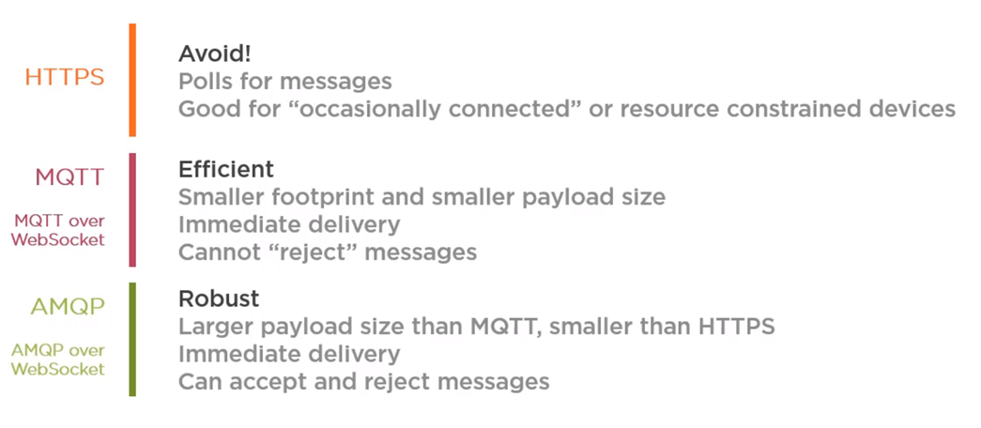
AWS iot
HTTPS
MQTT
AMQP over WebSockets

Slide 30
AWS vs Azure iot
There are many similarities (console interaction, security, routing)
IoT Explorer in Azure vs AWS CLI
A feature in software is often mimicked in other competitors
Both are strong solutions, choose the one you with which you are most comfortable

Slide 31
Demo

Slide 32
Questions?
https://github.com/adammickelson/kcdc

Slide 33
Sources:
https://www.softwaretestinghelp.com/iot-devices/
https://images.google.com
https://internetofthingsagenda.techtarget.com/definition/Internet-of-Things-IoT
https://www.zdnet.com/article/what-is-the-internet-of-things-everything-you-need-to-know-about-the-iot-right-now/
https://www.happiestminds.com/Insights/internet-of-things/
https://aws.amazon.com/iot/
https://www.taygan.co/blog/2018/03/12/streaming-sensor-data-in-real-time-with-azure-iot-hub

